Slide 1

Explanations for Computer Vision
Department of Informatics
Research Group Social Computing
Technical University of Munich
Lab Course: Explainable AI
Zhuoling Li, Sherif Nekkah, Ishwor Subedi
Technical University of Munich
Department of Informatics
Research Group Social Computing
Munich, 09. February. 2022
Notes:
Zhuoling (0.5)

Slide 2
Introduction
Department of Informatics
Research Group Social Computing
Technical University of Munich
Integrate explanations in computer vision field?
Challenges:
Explaining black-box deep learning models
CV is a large topic -> Specifying a task to be explained
Main idea: explain object detection models
Motivation:
Object detection: a popular research field in CV
Fewer researches in explanations for object detection previously
Notes:
Zhuoling (1)

Slide 3
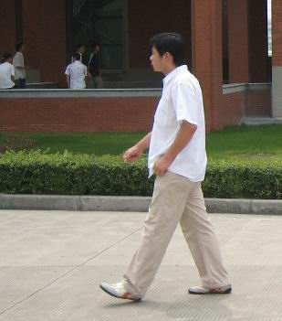
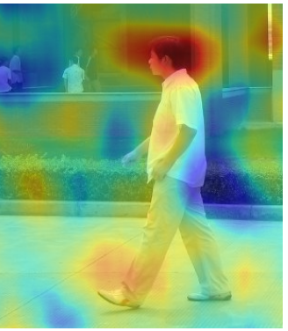
Object Detection Explainer
Department of Informatics
Research Group Social Computing
Technical University of Munich
Person: 98.83% -> Represents the class to be explained ✓
Object Detector
Explainer
-> measures the contribution of each (super)pixel on the detection
Notes:
Zhuoling (1)
TODO: Add image pair (original image & explained one)

Slide 4
Related Work
Department of Informatics
Research Group Social Computing
Technical University of Munich
Object detection explanation concept: SODEx [Sejr, 2021]
Explainer in CV: RISE [Petsiuk, 2018]
Our contribution:
Extending from SODEx:
Extending RISE from image classification to object detection tasks
 | SODEx | Our model
Object Detector | YOLOv4 | Faster RCNN
Explainer | LIME | LIME & RISE
[Sejr, 2021] Sejr, J. H., Schneider-Kamp, P., & Ayoub, N. (2021). Surrogate object detection explainer (sodex) with Yolov4 and lime. Machine Learning and Knowledge Extraction, 3(3), 662–671. https://doi.org/10.3390/make3030033 [Petsiuk, 2018] Petsiuk, V., Das, A., & Saenko, K. (2018). RISE: Randomized Input Sampling for Explanation of Black-box Models.
Notes:
Zhuoling (1.5)

Slide 5
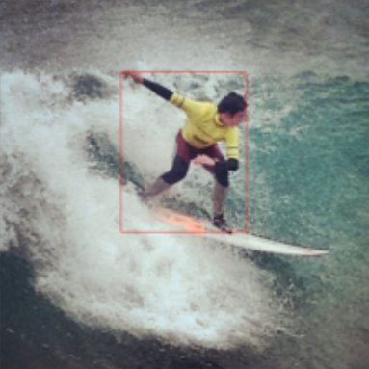
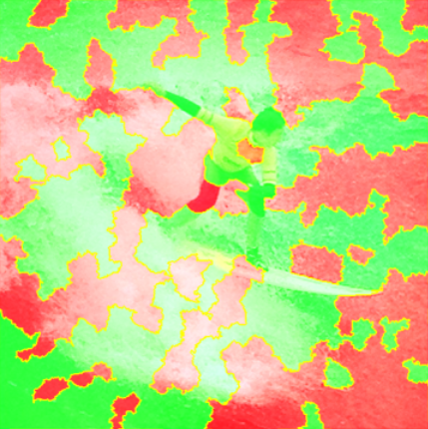
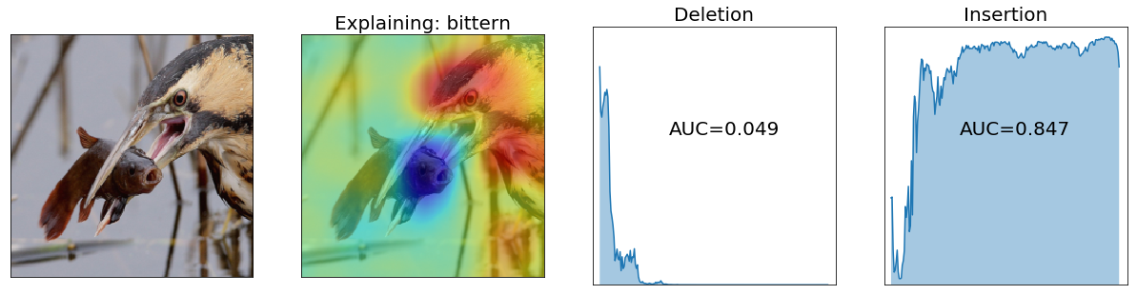
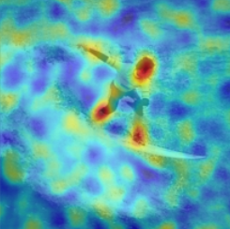

Pipeline
Department of Informatics
Research Group Social Computing
Technical University of Munich
Model
Evaluation
Object Detector
LIME Explainer
Superpixel segmentation
Insertion/Deletion
RISE Explainer
Saliency map generation
Data
Original Image
Notes:
Zhuoling (1.5)

Slide 6
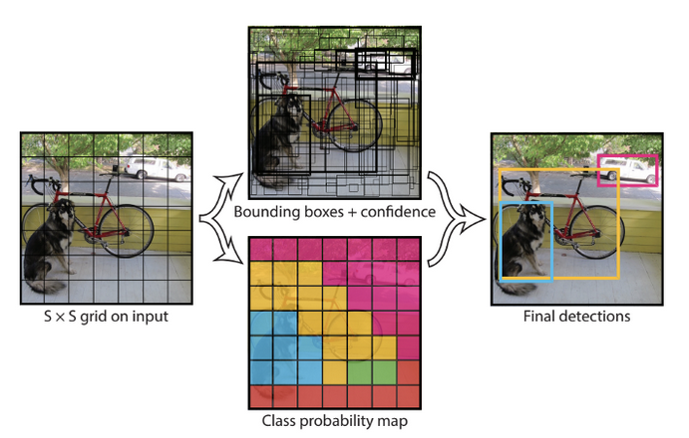
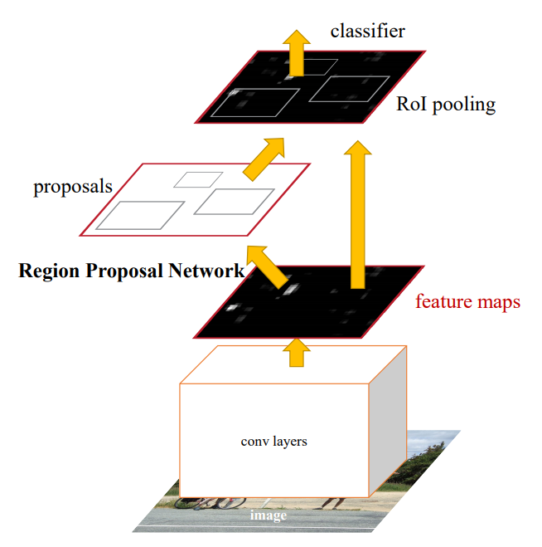
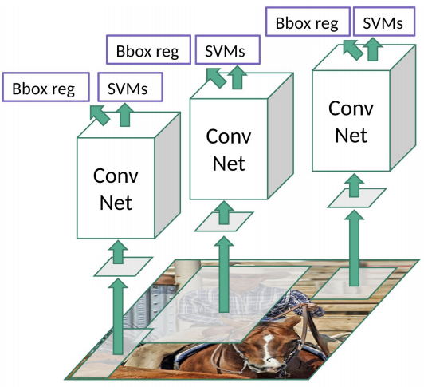
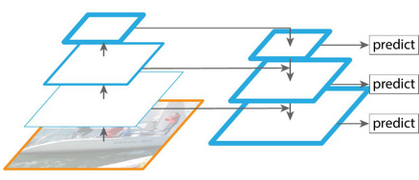
Object Detection
Department of Informatics
Research Group Social Computing
Technical University of Munich
YOLO
RCNN
Feature Pyramid Network (FPN) - feature extractor
Faster RCNN
Two-staged object detection
Source: https://towardsdatascience.com/r-cnn-fast-r-cnn-faster-r-cnn-yolo-object-detection-algorithms-36d53571365e
Notes:
Sherif (2.5)
Different kinds of network architectures for object detection
One-staged object detection
YOLO
Used in the SODEx Paper
Split image into SxS grid
predict m bounding boxes in each cell
Calculate class probability for each bounding box
Threshold highest value and assign to grid cell
Results in looots of bounding boxes
Non maxima-supression to reduce number of bboxes
Combining bounding boxes across cells via intersection over union
Two-staged object detection
Divides object detection step in two steps
1) Region proposals; 2) classification (both steps usually include feature extraction modules)
RCNN
Region-based convolutional neural network
2000 fixed region proposals
Selective search, based on some segmentation
Feature extraction (CONV NET) + classification with SVM
Also predict offset values to bbox proposal (BBOX reg)
Faster RCNN
Region proposal netowrk for bbox proposals
Classifier network for classification
Fast RCNN is something inbetween (not on the slide - also uses selective search)
Feature pyramid network
State of the art feature extractor
Used as backbone (conv layers)
Previously very deep networks output feature maps after a lot of convolutions
Small objects might be filtered out
In general the depth of the network is a design desicion related to the problem
FPN feature extractor aims to be one solution for all
Multi scale feature maps -> bounding box proposals on different maps
Captures different features sizes (e.g. pedestrian vs. bus)

Slide 7
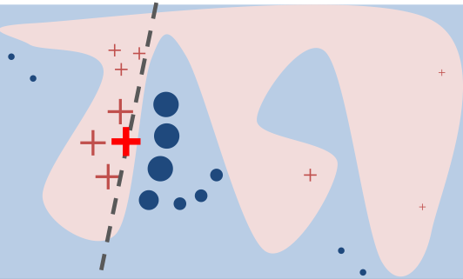

Explainer: LIME [Ribeiro, 2016]
Department of Informatics
Research Group Social Computing
Technical University of Munich
Local interpretable model agnostic explainer
Focuses on training local surrogate model, explains individual predictions
Generates samples around X and corresponding predictions
Non-linear decision function
Instance “X” to be explained
Linear model that approximates the model locally well near “X”
Source: https://github.com/marcotcr/lime
[Ribeiro, 2016] Ribeiro, M. T., Singh, S., &amp; Guestrin, C. (2016). "why should I trust you?". Proceedings of the 22nd ACM SIGKDD International Conference on Knowledge Discovery and Data Mining. https://doi.org/10.1145/2939672.2939778
Notes:
Ishwor (1)
Generates dataset of perturbed samples and corresponding predictions
Trains interpretable model(e.g LASSO) on this dataset

Slide 8
LIME: Training Recipe
Department of Informatics
Research Group Social Computing
Technical University of Munich
Select your instance of interest
Perturb your dataset and get prediction from black box model
Weight new samples with proximity with instance of interest
Train a weighted, interpretable model (for e.g. LASSO ) on the dataset
explanations(x) = argmin _{g∈G} L(f, g, π_{x}) + Ω(g)
-x instance of interest
-f , model being explained
- g local interpretable model
-L(f,g,π_{x}) square error loss.
-L(f, g, π_{x}) = ∑ _{z,z’∈Z} π_{x}(z) (f(z) − g(z’)) ²
Explain the prediction by interpreting the local model
Source: https://christophm.github.io/interpretable-ml-book/lime.html
Notes:
Ishwor (2)

Slide 9
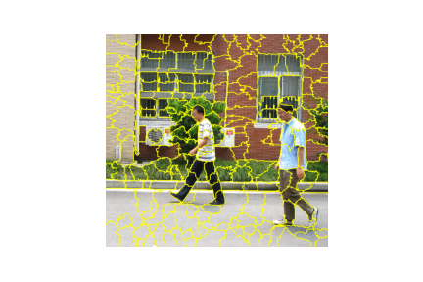
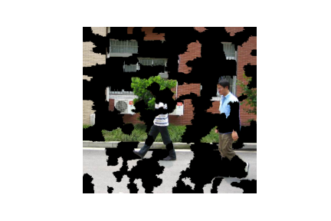
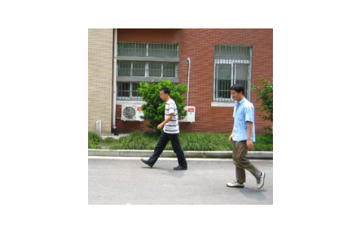
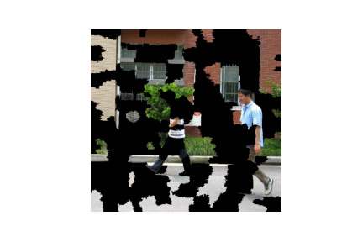
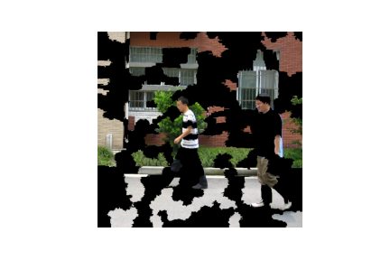
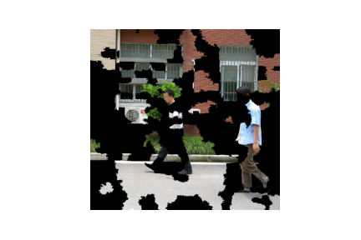
LIME
Department of Informatics
Research Group Social Computing
Technical University of Munich
Notes:
Ishwor (0.5)

Slide 10
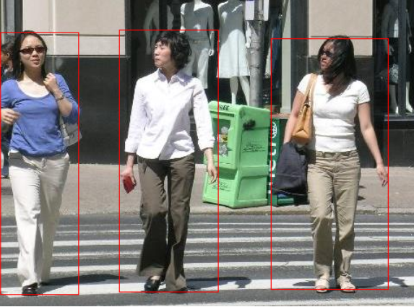
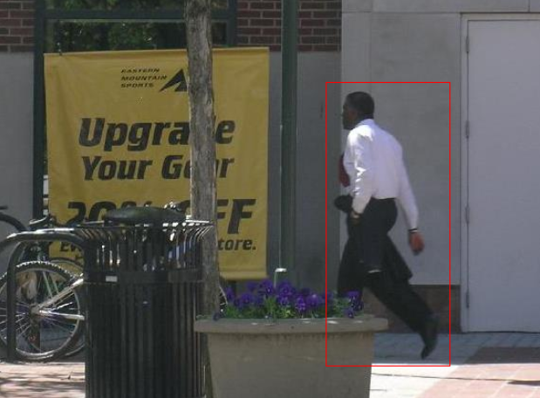
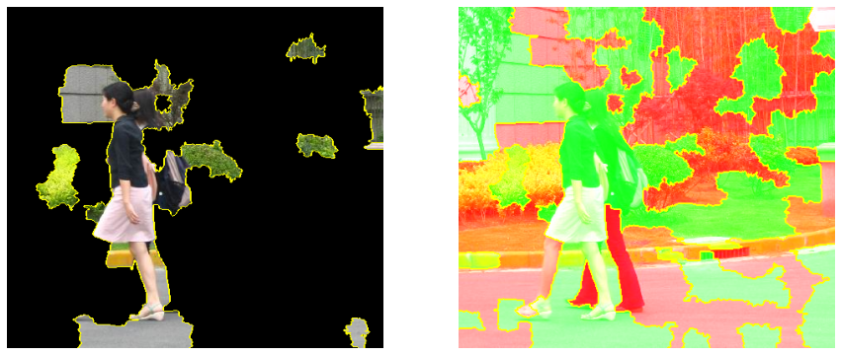
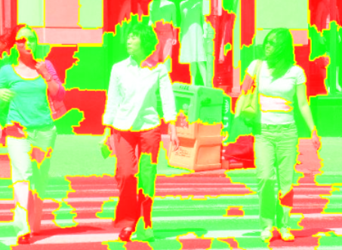
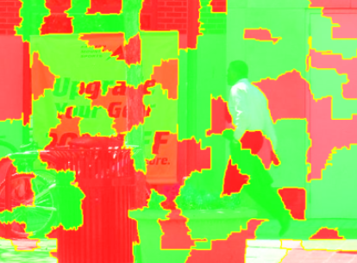
Lime Demo
Notes:
Sherif (0.5)
Results are difficult to interpret
Unclear explanation

Slide 11
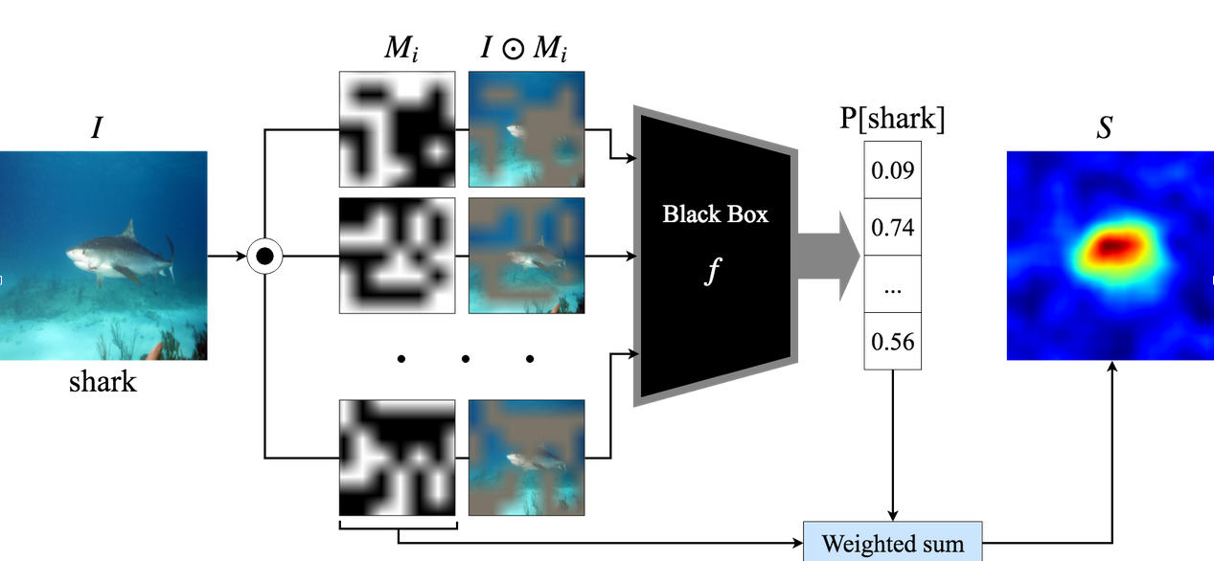
RISE Explainer
Department of Informatics
Research Group Social Computing
Technical University of Munich
Depiction of RISE explainer
Source: https://github.com/eclique/RISE
Notes:
Sherif (1.5)
Explainer for object classification
Analyzes the full image, not only the detection
Creation of N random binary masks
Blurring of the masks
Applying every mask to the inputted
Classify perturbed image
Weighted sum of masks and scores to create saliency map
Adaption due to SODEx Explainer algorithm
Perform object detection on the perturbed image and use score of object with the highest probability of the class we are trying to explain

Slide 12
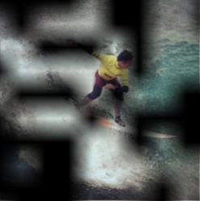
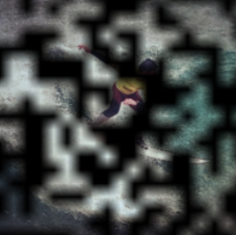
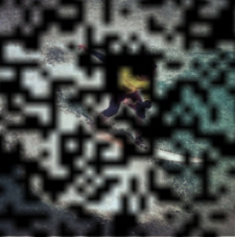
RISE Explainer
Department of Informatics
Research Group Social Computing
Technical University of Munich
s = 10
s = 20
s = 30
Sampling of N random binary masks + smoothing
Parameters
Number of masks N
Grid size s
Notes:
Sherif (0.5)
Influence of mask params to runtime and result

Slide 13
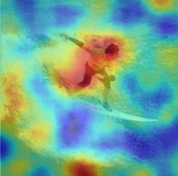
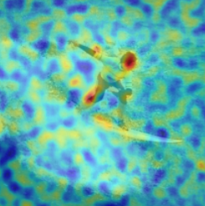
RISE Explainer
Department of Informatics
Research Group Social Computing
Technical University of Munich
s = 10
s = 20
s = 30
Sampling of N random binary masks + smoothing
Parameters
Number of masks N
Grid size s
Notes:
Sherif (0.5)
Influence of mask params to runtime and result

Slide 14
Implementation Details
Department of Informatics
Research Group Social Computing
Technical University of Munich
Hardware Settings
Google Colab
NVIDIA Tesla v100 GPU with 32GB memory on Linux ppc64le platform
Model
Backbone: ResNet-18, ResNet-50 FPN
Dataset
Penn-Fudan Pedestrian Dataset [1]
COCO Dataset [2]
Evaluation metric
Insertion/Deletion
¹ https://www.cis.upenn.edu/~jshi/ped_html/
² https://cocodataset.org/#home
Notes:
Zhuoling (0.5)

Slide 15
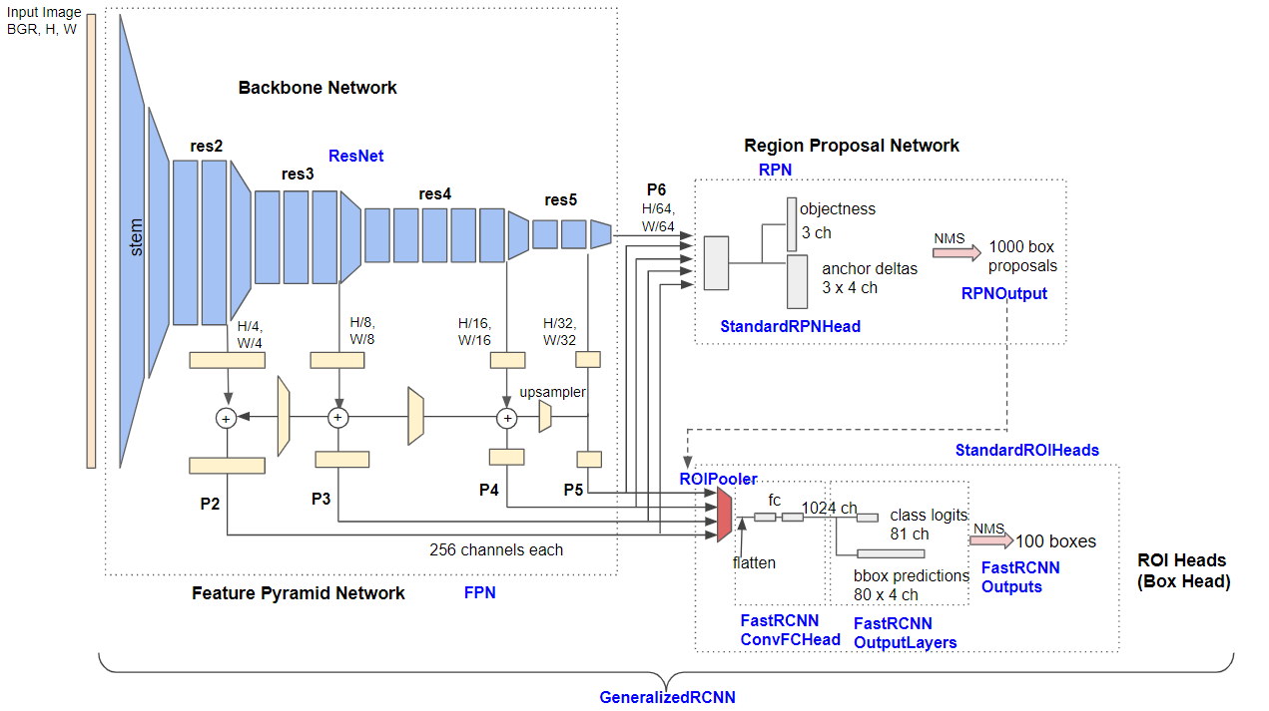
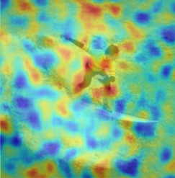
Model & Dataset
Department of Informatics
Research Group Social Computing
Technical University of Munich
PennFudan Dataset
Resnet 18 Feature Pyramid Network (FPN)
Sample explanation
Samples from the PennFudan Dataset Classes: 1
Source: https://www.cis.upenn.edu/~jshi/ped_html/
Faster RCNN - Resnet 18 FPN
Source: https://towardsdatascience.com/review-fpn-feature-pyramid-network-object-detection-262fc7482610
Notes:
Sherif (0.5)
Setup
PennFudan (pedestrian dataset)
Resnet18FPN FasterRCNN
Results unsatisfying

Slide 16
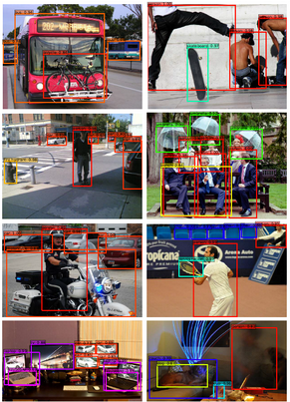
Model & Dataset
Department of Informatics
Research Group Social Computing
Technical University of Munich
Coco Dataset
Resnet 50 Feature Pyramid Network (FPN)
Sample explanation
Samples from the COCO Dataset Classes: 91
Source: https://cocodataset.org
Faster RCNN - Resnet 50 FPN
Source: https://towardsdatascience.com/review-fpn-feature-pyramid-network-object-detection-262fc7482610
Notes:
Sherif (0.5)
Setup
COCO (pedestrian dataset)
Resnet50FPN FasterRCNN
Better results

Slide 17
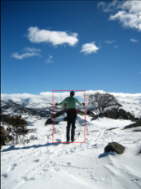
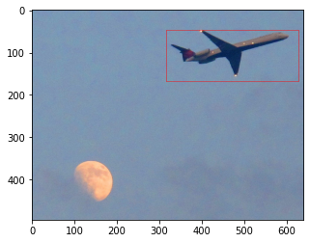
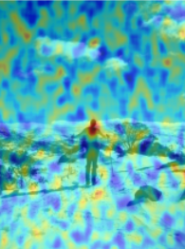
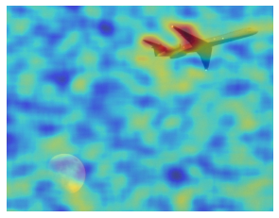
Rise demo
Department of Informatics
Research Group Social Computing
Technical University of Munich
Person
Person
Plane
s = 30
N = 1000
s = 20
N = 1000
s = 20
N = 1000
Notes:
Sherif (1)
Rise explainer
Object detection as red box
Explain saliency map colors
Different grid sizes required for different object sizes
Generalization is obvious
Person
Looking for Head, sometimes Hand and feet
Still having artefacts -> longer network training might improve as well

Slide 18
Comparison
Department of Informatics
Research Group Social Computing
Technical University of Munich
original image
LIME explanation
RISE explanation
Notes:
Ishwor (0.5)

Slide 19
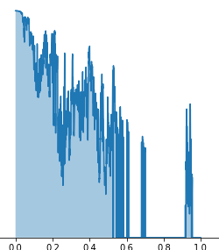

Evaluation Metrics
Department of Informatics
Research Group Social Computing
Technical University of Munich
Insertion & Deletion [Petsiuk, 2018]
Randomly blur/unblur regions and measure the impact on the explanation
Higher AUC indicates better explanation!
[Petsiuk, 2018] Petsiuk, V., Das, A., & Saenko, K. (2018). RISE: Randomized Input Sampling for Explanation of Black-box Models.
Notes:
Ishwor (1)

Slide 20
Conclusion
Department of Informatics
Research Group Social Computing
Technical University of Munich
Problem Statement
How to explain object detectors?
Approach
Object detection explainer with Faster RCNN, LIME and RISE
Experiments
In general: pixels inside the bounding boxes more contributed
Comparable performance of models using different backbones and explainers on different datasets
ResNet-50 backbone on COCO dataset: better generalization
LIME results: difficult to interpret
Evaluation
Judging the qualitative & quantitative results of the explanation
Notes:
Zhuoling (1)

Slide 21
Outlook
Department of Informatics
Research Group Social Computing
Technical University of Munich
Improvement
Insertion/Deletion
Implementation
Scaling explanations to decrease development time
Other related Work
D-RISE (proposed by the same team as RISE) [Petsiuk, 2021]
Saliency-based explainer
Generate multiple saliency maps and average them
[Petsiuk, 2021] Petsiuk, V. et al., 2021. Black-box explanation of object detectors via saliency maps. 2021 IEEE/CVF Conference on Computer Vision and Pattern Recognition (CVPR).
Notes:
TODO (0.5)

Slide 22
Department of Informatics
Research Group Social Computing
Technical University of Munich
Thank you very much for your attention!

Slide 23
Evaluation metrics
Causal metrics: Insertion/Deletion
Insertion: start with highly blurred images and gradually unblur regions
Deletion: in complementary manner
Measure an increase/decrease in the probability of the predicted class as more and more important pixels are added/removed
Pointing game accuracy
Verify the single pixel with the highest relevance lies inside the human-annotated bounding box -> counted as a hit
Acc. for one class: #hits / (#hits + #misses)
Mean acc. over all classes
Absolute average weight in-out ratio (regarding the bounding box)
Quantitative analysis for one explainer

Slide 24
Challenges and Next steps
Explanations are not very useful yet
Dataset only contains one class
The network might choose any feature to classify the object as pedestrian
Training on the COCO dataset on-going
No evaluation metric to compare LIME and RISE quantitatively
Couldn’t tweak insertion/ deletion for object detection
Pointing game acc. not suitable for LIME
Next steps :
Adapt to new resources
Issues with the provided resources
Enlarge the dataset: train explainer on the COCO dataset (91 classes)
Use larger models (ResNet18 -> ResNet50)
D-RISE

